Slide 1
Introduction to FHIR
Lloyd McKenzie
Sept. 23, 2013

Slide 2
This presentation
Can be downloaded here:
http://gforge.hl7.org/svn/fhir/trunk/presentations/2013-05 Tutorials/Introduction to FHIR.pptx
Is licensed for use under the Creative Commons, specifically:
Creative Commons Attribution 3.0 Unported License
(Do with it as you wish, so long as you give credit)

Slide 3
Who am I?
Name: Lloyd McKenzie
Company: Gordon Point Informatics (GPi)
Background:
One of FHIR’s 3 principle editors
Co-chair FHIR Management Group
Co-chair HL7 Modeling & Methodology
Chair HL7 Canada Architecture & Infrastructure
Heavily involved in HL7 and healthcare exchange for last 14 years (v2, v3, CDA, etc.)

Slide 4
Who are you?
What’s your background with HL7?
v2? v3? CDA? Brand new?
What’s your role?
Developer? Manager? Clinician? Other?
What’s the single most important thing for you to get out of today’s course?

Slide 5
Tutorial Objectives
You should:
Be able to explain what FHIR is to others in your organization
Know where FHIR fits in the broader healthcare landscape, including other HL7 specifications
Be equipped to help your organization determine if, when, where and how you might use FHIR
Know how to approach the FHIR specification to find out what more you need to know
Notes:
9:15

Slide 6
What is FHIR?

Slide 7

Answer: An instigator of bad puns
FHIR is the hottest thing since . . .
This spec is spreading like . . .
Committee X is really on FHIR
Feel free to come up with your own
(but please, not here ☺)

Slide 8
The Need
Has been a need to share healthcare information electronically for a long time
HL7 v2 is over 25 years old
Increasing pressure to broaden scope of sharing
Across organizations, disciplines, even borders
Mobile & cloud-based applications
Faster – integration in days or weeks, not months or years
Notes:
Who

Slide 9
The Need
Q: So what did HL7 have to offer in this space?
A: Not much
V3 attempted to address some of these issues, but too slow and too hard
CDA has had the most success, but both limited and still too hard

Slide 10

Genesis of FHIR
HL7 undertook a “Fresh look”
What would healthcare exchange look like if we started from scratch using modern approaches?
Web search for success markers led to RESTful based APIs
Exemplar: Highrise (https://github.com/37signals/highrise-api)
Drafted a healthcare exchange API based on this approach

Slide 11
The acronym
F – Fast (to design & to implement)
Relative – No technology can make integration as fast as we’d like
H – Health
That’s why we’re here
I – Interoperable
Ditto
R – Resources
Building blocks – more on these to follow
Notes:
9:25

Slide 12
FHIR Principles

Slide 13
FHIR Manifesto
Focus on Implementers
Target support for common scenarios
Leverage cross-industry web technologies
Require human readability as base level of interoperability
Make content freely available
Support multiple paradigms & architectures
Demonstrate best practice governance
Notes:
We don’t actually have a formal manifesto, but these are the principles we adhere to.

Slide 14
Implementer Focus
Specification is written for one target audience: implementers
Rationale, modeling approaches, etc. kept elsewhere
Multiple reference implementations from day 1
Publicly available test servers
Starter APIs published with spec
Delphi, C#, Java – more to come
Connectathons to verify specification approaches
Instances you can read and understand ☺
Lots of examples (and they’re valid too)
using HL7.Fhir.Instance.Model;
using HL7.Fhir.Instance.Parsers;
using HL7.Fhir.Instance.Support;
XmlReader xr = XmlReader.Create(
new StreamRead
IFhirReader r = new XmlFhirReader
// JsonTextReader jr = new JsonTe
// new StreamRead
// IFhirReader r = new JsonFhirRe
ErrorList errors = new ErrorList(
LabReport rep = (LabReport)Resour
Assert.IsTrue(errors.Count() == 0
Notes:
Who’s read the v3 spec? – modeler & balloter focused
Spec is driven by people who write code
Numerous pieces have been changed because of experience with what worked when trying to implement
Even have a test workbench for RESTful servers

Slide 15
Support “Common” Scenarios
80%
Inclusion of content in core specification is based on “80%” rule
“We only include data elements if we are confident that 80% of implementations maintaining that resource will make use of the element”
Other content pushed to extensions
(more on this later)
Easy to say, governance challenge to achieve
Notes:
Design by constraint failed – years to develop, what was produced required yet more design to be implementable and after that might not be interoperable
How to determine the 80%? Look to existing specs – v2, v3, CDA templates, OpenEHR, jurisdictional projects, what implementations we’ve seen
If not sure, err on the side of “not in for now”
Note: not 80% of instances, 80% of implementations
Challenges with “raising the bar”
What happens when there aren’t many/any implementations?

Slide 16
Web technologies
Instances shared using XML & JSON
Collections represented using ATOM
Same technology that gives you your daily news summary
Out-of-the-box publish/subscribe
Web calls work the same way they do for Facebook & Twitter
Rely on HTTPS, OAuth, etc. for security functions
http://...
Notes:
We try very hard to *not* invent stuff that exists elsewhere unless it’s really broken or totally unaligned with the FHIR principles.

Slide 17

Human Readable
CDA taught HL7 a very important lesson
Even if the computers don’t understand 99% of what you’re sending, that’s ok if they can properly render it to a human clinician
This doesn’t just hold for documents – important for messages, services, etc.
In FHIR, every resource is required to have a human-readable expression
Can be direct rendering or human entered
Notes:
Even when you think your target will understand all the encoded data, reality is data often gets shared beyond the originally intended context
Allow for exceptions for things like automated device readings, etc.

Slide 18
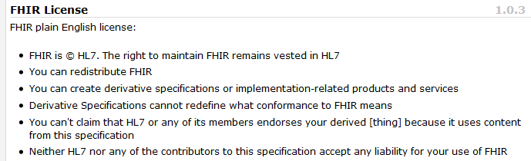
Freely available
Unencumbered – free for use, no membership required
http://hl7.org/fhir
Notes:
Was a bigger deal before HL7 decided to open up all IP
full legal text towards bottom of FHIR home page

Slide 19
Governance
Oversight
TSC
Governance
FGB
Methodology
MnM
Management
FMG
Content
Core Team
Content
Work Groups
Notes:
FHIR Governance Board
Maintains FHIR principles
Identifies risks, precepts
Handles coordination w/ external groups
FHIR Management Group
Coordinates Work Groups
Manages ballot process
Education delivery
Day-to-day activities
Modeling & Methodology
Defines criteria for artifacts
Determines processes
Documents best practices
Work Groups
Do the actual development work
Core Team
Temporary
Takes on work Work Groups can’t
Expedites
What haven’t we talked about yet?

Slide 20
Paradigms and Architectures
Notes:
9:45

Slide 21
Paradigms
FHIR supports 4 interoperability paradigms
REST
Documents
Messages
Services

Slide 22
REST
Simple, out-of-the-box interoperability
Leverage HTTP: GET, POST, etc.
Pre-defined operations
Create, Read, Update, Delete
Also: History, Read Version, Search, Updates, Validate, Conformance & Batch
Works best in environments where control resides on client side and trust relationship exists
Rest
Notes:
URLs, parameters, etc. all defined
Choice of what operations to support
Behavior documented in conformance profile - mandatory

Slide 23
Documents
Similar to CDA
Collection of resources bound together
Root is a “Document” resource
Just like CDA header
Sent as an ATOM feed
One context
Can be signed, authenticated, etc.
Documents

Slide 24
Messages
Similar to v2 and v3 messaging
Also a collection of resources as an ATOM feed
Allows request/response behavior with bundles for both request and response
Event-driven
E.g. Send lab order, get back result
Can be asynchronous
Messages

Slide 25
Service Oriented Architecture (SOA)
Do whatever you like
(based on SOA principles)
Ultra complex workflows
Ultra simple workflows
Individual resources or collections (in Atom or other formats)
Use HTTP or use something else
Only constraint is that you’re passing around FHIR resources in some shape or manner
Services

Slide 26
Paradigms
Regardless of paradigm the content is the same
This means it’s straight-forward to share content across paradigms
E.g. Receive a lab result in a message. Package it in a discharge summary document
It also means constraints can be shared across paradigms
E.g. Define a profile for Blood Pressure and use it on resources in messages, documents, REST and services

Slide 27
Architectures
FHIR makes no assumptions about the architectural design of systems
You can use it for
Light or heavy clients
Central server or peer-to-peer sharing
Push or pull
Query or publish/subscribe
Loosely coupled or tightly coupled environments
With history tracking or without

Slide 28
FHIR Resources
Notes:
10:00

Slide 29

Resources
“Resources” are:
Small logically discrete units of exchange
Defined behaviour and meaning
Known identity / location
Smallest unit of transaction
“of interest” to healthcare
V2: Sort of like Segments
V3: Sort of like CMETs

Slide 30
What’s a Resource?
Examples
Non-examples
Administrative
Patient, Practitioner, Organization, Location, Coverage, Invoice
Clinical Concepts
Allergy, Condition, Family History, Care Plan
Infrastructure
Document, Message, Profile, Conformance
Gender
Too small
Electronic Health Record
Too big
Blood Pressure
Too specific
Intervention
Too broad
100-150 total - ever
Notes:
And few systems will ever see more than 40-50

Slide 31
Resources
Resources have 3 parts
Extensions
Narrative
Defined
Structured
Data
Notes:
Defined Structured Data
The logical, common contents of the resource
Mapped to formal definitions/RIM & other formats
Extensions
“Non-common” requirements, but everyone can use
Published and managed
Narrative
Human readable (fall back)

Slide 32
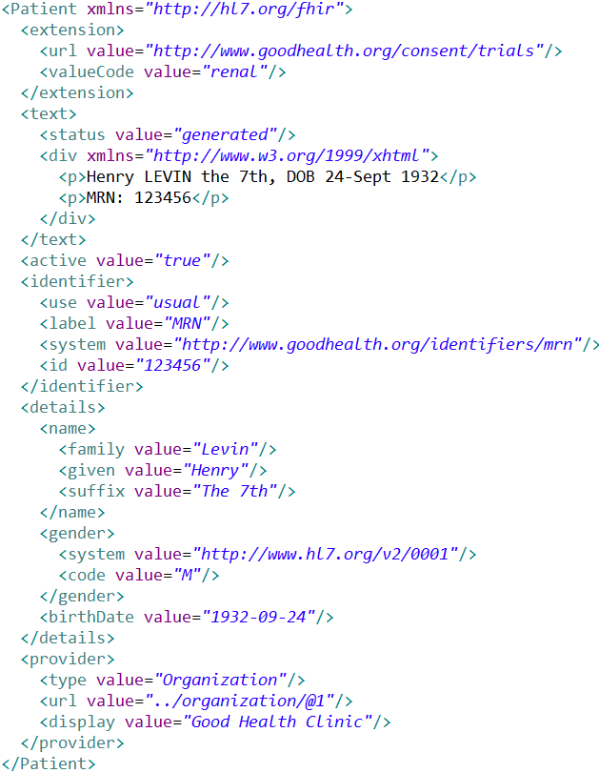
Extension with reference to its definition
Human Readable Summary
Standard Data Content:
MRN
Name
Gender
Date of Birth
Provider
Notes:
System for gender is wrong . . .

Slide 33
Resource elements
Resources are defined as an XML structure based on desired wire syntax
Hierarchy of elements
Each element has
Name
Either a datatype or nested elements
Cardinality
All collections are nested in a containing element
Definition
RIM mapping

Slide 34
It’s all about the resources . . .
Location
Lab
Report
Related
Person
Patient
Practitioner

Slide 35
FHIR Extensions
Notes:
10:15

Slide 36
The Case for Extensions
Extensions are often problematic in existing HL7 specs
Z-segments in v2
What does this mean?
ZSB|20080117|Q^57|4.30^uL
Foreign namespaces in CDA/V3
Break schemas
Simple choice – design for absolutely everything or allow extensions

Slide 37
Extensions without the pain…
Extensions are built into the wire format
All conformant systems can “handle” any possible extension - Just a bucket of “other stuff”
Use mustUnderstand to flag extensions that “change things”
Require formal definitions of extensions to be available in interoperability space
Extensions rendered in human readable portion

Slide 38
Reading the FHIR Spec

Slide 39
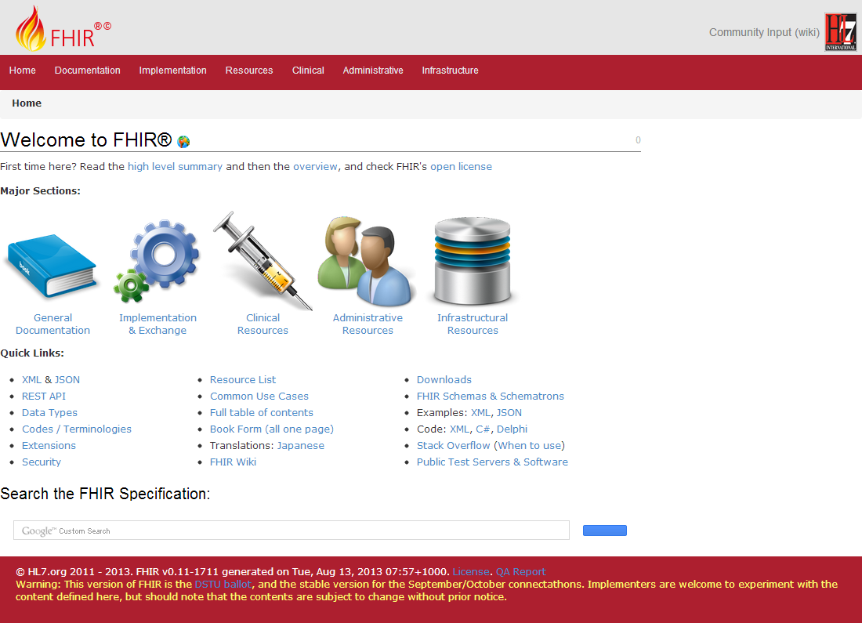
(FHIR home)
hl7.org/fhir
Notes:
Published as HTML
Published using validation process that performs consistency checks
Really shouldn’t require much guidance to read, but a few things to call out
Objective of spec is developer can skim and decide in < day

Slide 40
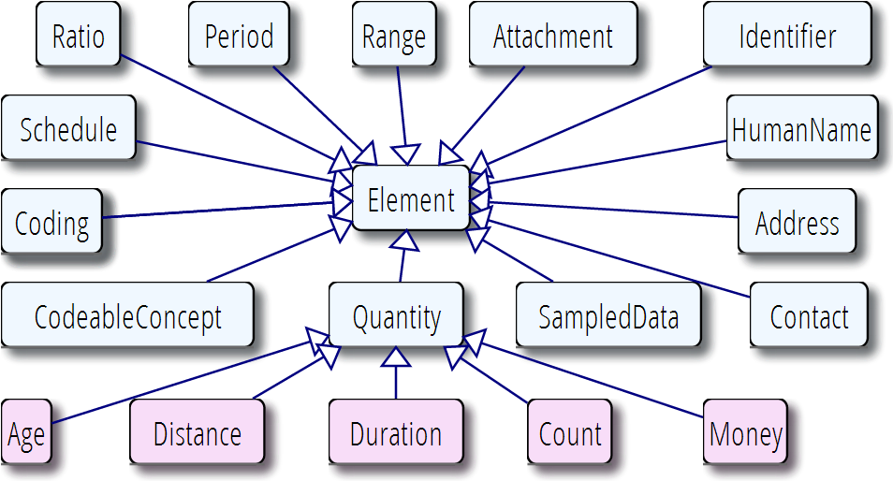
Data types

Slide 41
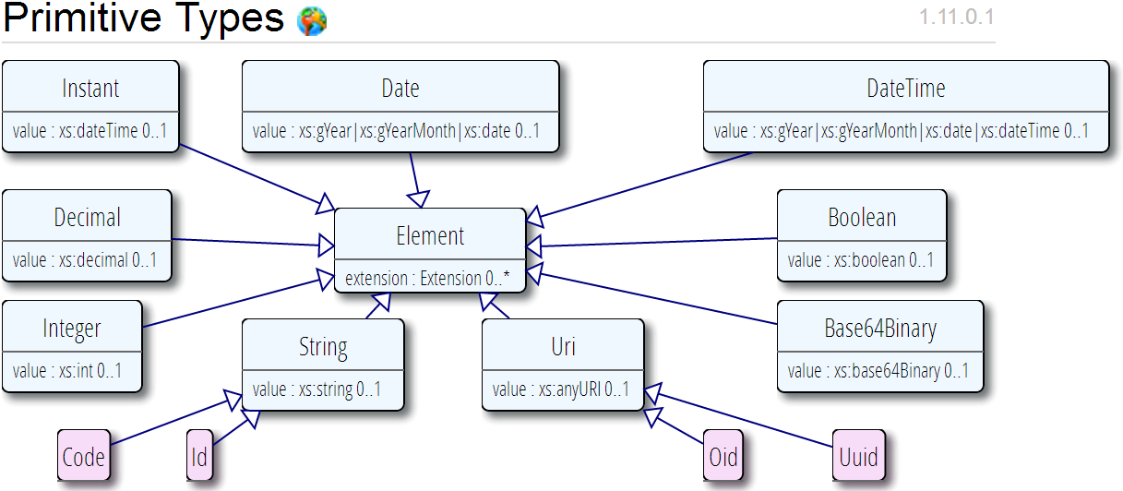
Data types (cont’d)
Based on w3c schema and ISO data types
Stick to the “80% rule” – only expose what most will use
Data types can have extensions too

Slide 42
Example – CD datatype
ISO
Code, code system, code system name, code system version, value set id, value set version, coding rationale, updateMode, flavorId, nullFlavor, controlAct root & extension, validTime low and high
displayName with language and translations
originalText with mediaType, language, compression, integrityCheck, thumbnail, description, translations, reference (can be text, video, whatever)
Translations (most of same info as code)
Source code

Slide 43
Example – CD datatype
FHIR
Code, code system, code system name, code system version, value set id, value set version coding rationale, updateMode, flavorId, nullFlavor, controlAct root & extension, validTime low and high
displayName with language and translations
originalText with mediaType, language, compression, integrityCheck, thumbnail, description, translations, reference (can be text, video, whatever)
Translations (most of same info as code)
Source code

Slide 44
Vocabulary
Support for coded data of varying complexity
Some codes defined as part of resource, others referenced from external vocabularies
LOINC, SNOMED, UCUM, etc.
Recognition some will differ by implementation space
Can use Value Set resource to define more complex code lists

Slide 45
FHIR Document
A point in time collection of resources
Can be a ‘stand alone’ document (like CDA) or a aggregated resource type (often profiled)
‘child’ resources are like CDA sections
Atom
Document Resource
Resource 1
Resource 2

Slide 46
FHIR Message
Collection of resources sent as a result of some real-world event intended to accomplish a particular purpose
Event Codes & Definitions, like HL7 v2
V2 segments broadly map to resources
Includes a “Message” resource, similar in purpose to Message wrapper and MSH segment
May have associated behavior
Can be conveyed via MLLP, SOAP or other means
Atom
Message Resource
Resource 1
Resource 2
Notes:
10:30

Slide 47
Profiles
Document constraints and extensions on one or more resources
May also define new extensions search terms, new messaging events, etc.
Subsumes: template, implementation profile, DCM (Detailed Clinical Model), etc.
Looks an awful lot like the definition of the resources themselves
You can download profile XML for all resources

Slide 48
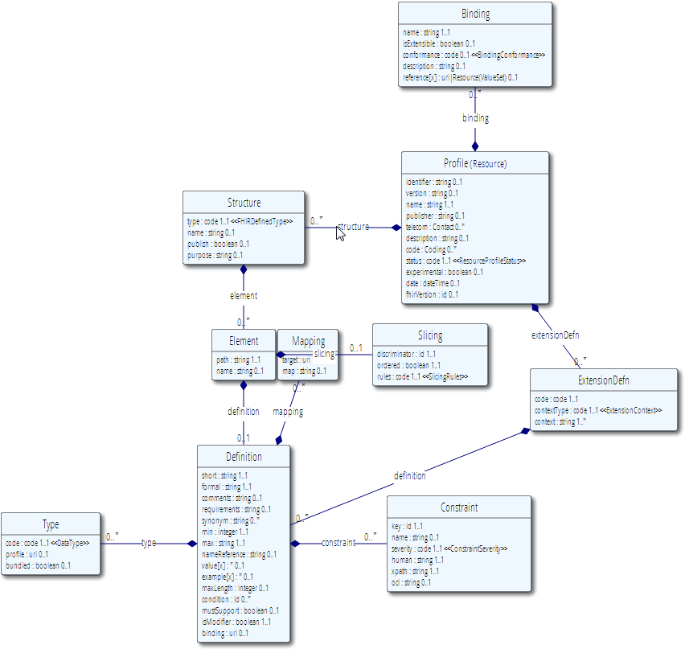
Profile (cont’d)

Slide 49
Conformance
There’s a resource for documenting conformance to FHIR
Can be used for:
Stating how a specific system instance behaves
Defining how a software system is capable of behaving (including configuration options)
Identifying a desired set of behavior (e.g. RFP)
To declare themselves “FHIR Conformant”, a system must publish a Conformance instance

Slide 50
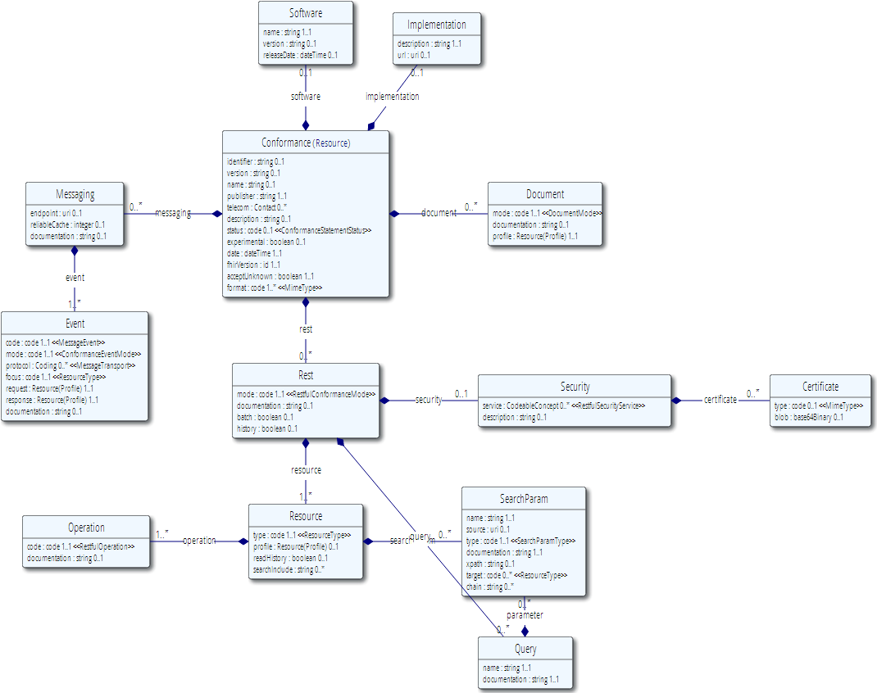
Conformance (cont’d)

Slide 51
Resource representations
Each resource is published with several views covering different aspects
UML diagram
Simple pseudo-XML syntax
Vocabulary bindings
Notes
Search Criteria
Data dictionary
Example instance
Schema + Schematron
RDF, XMI, etc. to come

Slide 52
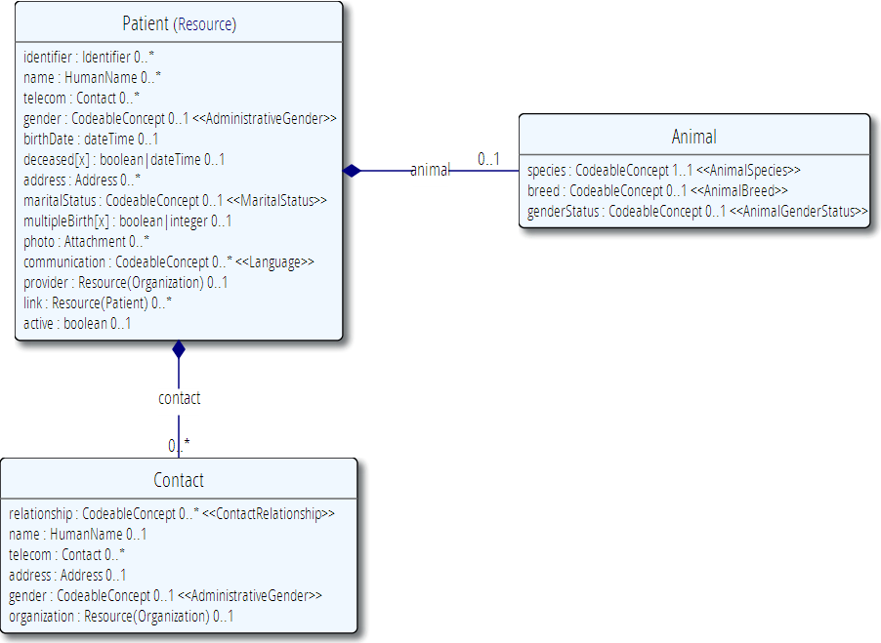
(FHIR person)

Slide 53
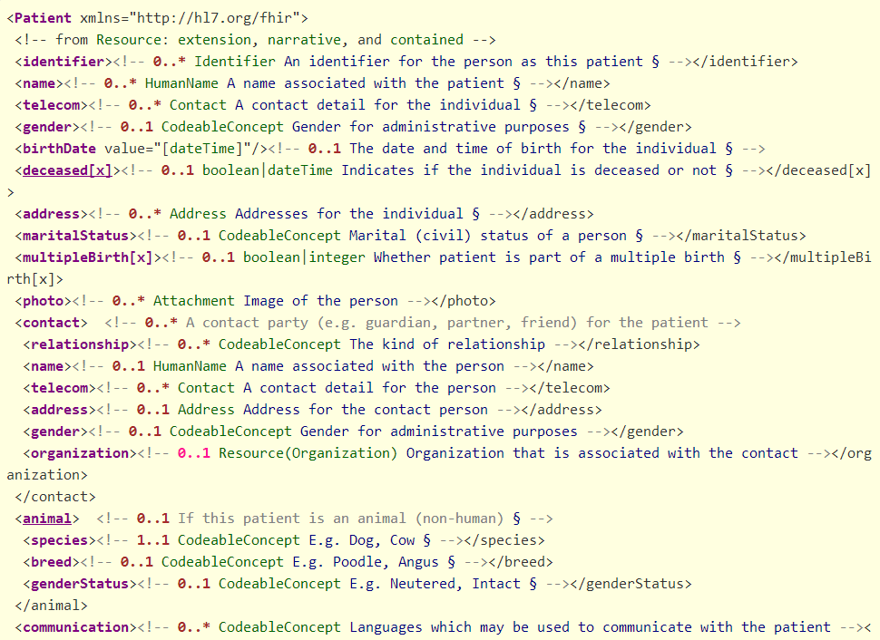

Slide 54
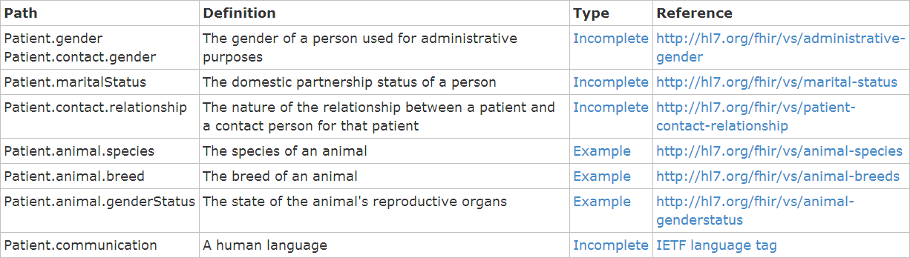
Vocabulary Bindings

Slide 55
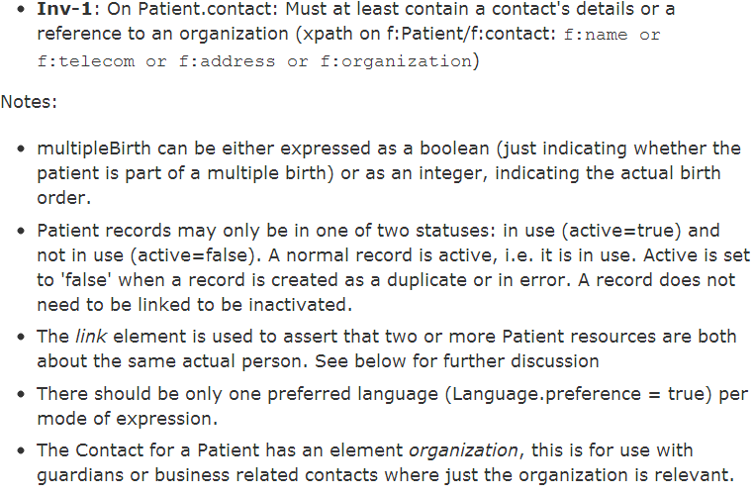
Constraints & Notes

Slide 56
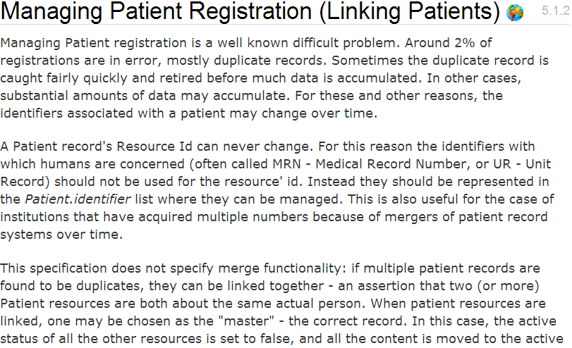
Additional Guidance

Slide 57
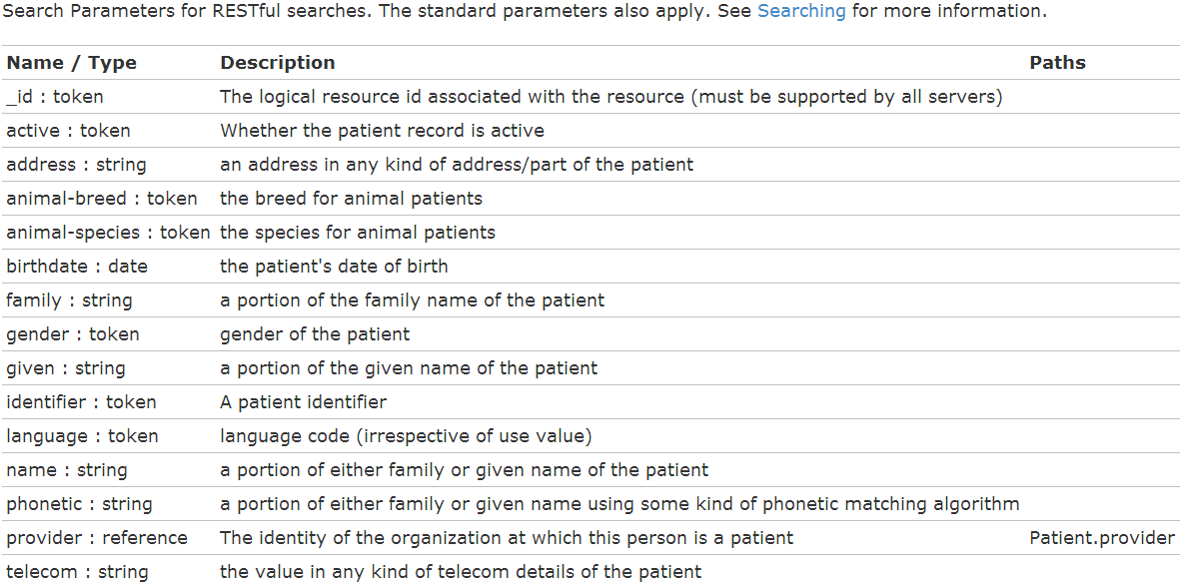
Search Parameters

Slide 58
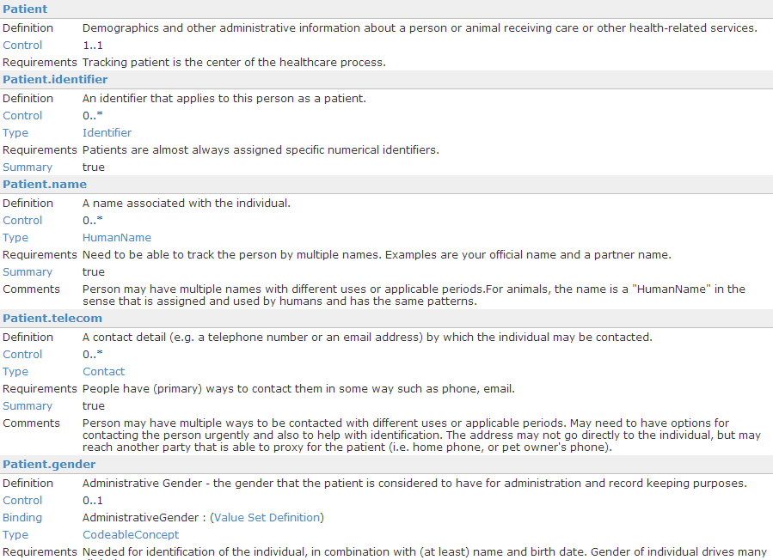
Example - Person

Slide 59
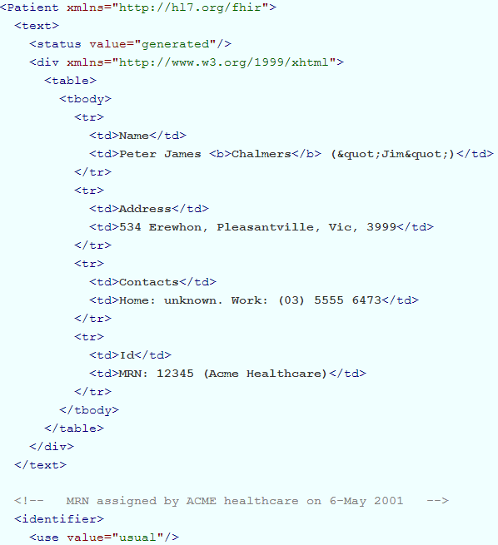
Example - Person

Slide 60
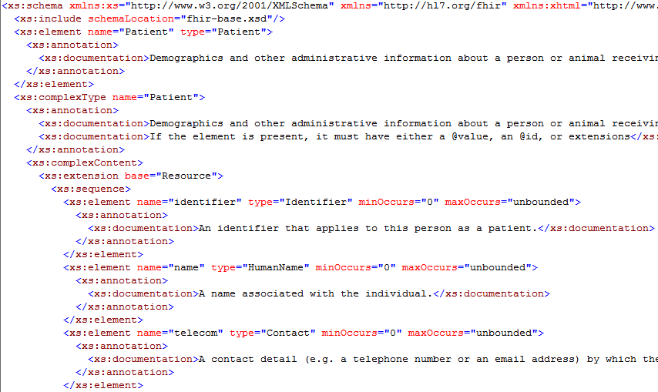
Schema

Slide 61
Let’s poke around the spec . . .
Notes:
11:15
Core elements, Examples, definitions
What do you think would be core in X?
wiki

Slide 62
How does FHIR compare?
Notes:
11:30

Slide 63



Wire syntax
v2
CDA
Character-delimited
No built-in parsers
Hard to read/debug
Few off-the-shelf validators
Semantics not visible in instance
XML with fixed schema
Language-supported parsers & validators
Complex nesting & naming
Semantics vary from clear to obtuse
v3
FHIR
XML with fixed schema
Language-supported parsers & validators
Complex nesting & naming
Semantics vary from clear to obtuse
XML & JSON with fixed schema
Language-supported parsers & validators
Simple structure
Semantics clear in instance
Notes:
11:45

Slide 64
Paradigms
v2
CDA
Document only
Some external infrastructure allows sort of treating like messages or services, but not well-suited
Messaging only
Documents as blobs in an OBX segment
v3
Primarily messaging
Supports documents (CDA and other)
Sometimes used in services
Frequently no wire compatibility between paradigm representations
FHIR
Supports REST, Message, Document and Services
Wire format (and profiles) consistent across paradigms

Slide 65
Implementer support
v2
CDA
Some examples
Discussion groups available, though often design rather than implementation-focused
Some tooling, not yet robust
Some 3rd party testing
Some connectathons
Some examples, not necessarily valid
Good industry support from 3rd party engines
v3
FHIR
Lots of examples
Reference implementations
Public validation servers
Generated APIs
Connectathons
Few, if any examples at Int’l level
Minimal tooling support
Implementation varies significantly by jurisdiction

Slide 66
Directly interoperable
v2
Significant configuration or interface engines required for interoperability
Must be profiled to be reasonably implemented
Few standard profiles available
CDA
Base specification too complex to implement directly
Popular templates such as CCDA are largely interoperable
Human-to-human interoperability provided
v3
Int’l specs generally require significant profiling for use
Profiling often done as re-design without wire compatibility
Little direct uptake of int’l specs
FHIR
Useful clinical interoperability out-of-the-box
Human-to-human interoperability provided
Extensions don’t block interoperability

Slide 67
Extensibility
v2
CDA
Extension via foreign namespace or special attribute
Semantics usually, not always, conveyed by element name
Extensions break schemas
Z-segments allow extension, but only link to extended content is positional
No extensions to data types
Extensions are opaque
v3
Extension via foreign namespace or special attribute
Semantics usually, not always, conveyed by element name
Extensions break schemas
FHIR
Extensions built into schema
Extensions formally defined accessible online and re-usable

Slide 68
Human Readability
v2
CDA
No consistent syntax for human readability
Can be provided by site-specific agreement using (abusing?) NTE, OBX or Z-segments
Human readability a required part of specification
v3
FHIR
Not generally designed with human readability in mind
Can be supported if designers accommodate it or extensions used
Human readability a required part of specification

Slide 69
Robust Semantics
v2
No formal data model
Inconsistencies in data representation and granularity between segments
Semantics come from definitions with varying levels of quality
CDA
Formal data model
Fixed in time to old version
Limited semantic expressiveness in some situations
(May be addressed in new version)
v3
FHIR
Full mapping to formal data model where relevant
May map to multiple reference models (e.g. RIM + OpenEHR)
Formal data model
Fully expressive of semantics
Notes:
This is where v3 gets it’s only check-mark

Slide 70
So if FHIR’s so great, why would we do anything else?

Slide 71
Market Share
v2
CDA
De facto standard for in-institution communication
Standard in many countries for cross-institution communication
High market penetration, particularly of CCD and CCDA variants due to meaningful use
Significant on-going growth
v3
FHIR
Mandated use in a few jurisdictions
Little uptake outside of those mandates
None

Slide 72
Maturity
v2
In use for over 25 years
Broadly supported by industry tools
Now on
Familiarity with both capabilities and limitations (and work-arounds)
CDA
In use for over 12 years
Implemented in a variety of settings all around the world
v3
FHIR
First thought of less than 2 years ago
Not yet passed even DSTU ballot
Won’t be a normative spec for several more years, minimum
In development for over 13 years
Some specifications have had multiple releases
Limited uptake

Slide 73
Simple message
Yes, FHIR has the potential to supplant HL7 v3, CDA and even v2
However
It’s not going to do so any time soon
No one's going to throw away their investment in older standards to use FHIR until
The specification has a good track record
It’s clear the new thing provides significant benefits
HL7 will support existing product lines so long as the market needs them
Notes:
12:05

Slide 74

FHIR & other SDOs
IHE
investigating - use of FHIR for MHD (mobile XDS)
DICOM
interested - RESTful access to image metadata
W3C
Semantic health group helping us with RDF, RIM-based semantic checking
Because FHIR is free and because of how it’s structured, use by other SDOs is certainly possible

Slide 75
Implementing FHIR

Slide 76
Where can FHIR be used?
Classic in-institution interoperability
Back-end e-business systems (e.g. financial)
Regional Health Information Organizations (RHIO)
National EHR systems
Social Web (Health)
Mobile Applications
Near
Term

Slide 77

Migration
Realistically, we don’t expect anyone to migrate existing interfaces any time soon.
Initial adopters will be green-field, new technology
FHIR may see use behind the scenes in v2 systems before it sees use over the wire

Slide 78
Migration – v2
Already have an integration engine that supports translation between v2 and FHIR
Resources map to segments reasonably well
As always, the challenge with v2 mapping is the variability of v2 interfaces
“Common” mappings can be created, but they won’t be one size fits all
HL7 v2

Slide 79
Migration – v3
V3 migrations should be more straight-forward as semantics are clear
Migrations will tend to be based on templates and realm constraints rather than international specs
Round-trip transforms are possible
Which get targeted first will depend on implementer desires
HL7 v3

Slide 80

Migration – CDA
Made more complex by human-readable nature
Need to ensure text <-> entry linkages are retained
Will best be handled on a template by template basis
Likely start with important ones like C-CDA
Notes:
12:15
Text linkages not as important when not human-attested

Slide 81
What’s next?

Slide 82
Balloting plans
First Draft Standard for Trial Use ballot (DSTU) complete
Probably one more cylce, with DSTU publication in Jan 2014
Will provide a semi-stable platform for implementers while still allowing non-backward-compatible change for Normative version if implementation experience dictates
Additional DSTU versions roughly annually to make fixes, introduce new resources
Normative is around 3 years out
We want *lots* of implementation experience before committing to backward compatibility

Slide 83
Development plans
Performing rigorous QA on initial set of resources
Full support for C-CDA in first DSTU
Additional resources will continue to be introduced in future DSTU cycles as implementers identify needs
Continue to seek testing & real world implementation experience

Slide 84

Next Steps for you
Attend the FHIR Implementers tutorial
Read the spec: http://hl7.org/fhir
Comment on the wiki (link from FHIR spec)
Follow #FHIR on Twitter
Shape the specification:
Join the FHIR track at this WGM
Join the FHIR email list http://wiki.hl7.org/index.php?title=FHIR_email_list_subscription_instructions
Try implementing it
Make Ballot comments
Come to a Connectathon!

Slide 85
Review

Slide 86
What does FHIR provide?
Resources (building blocks)
Extensions
Methodology
Bundles, Profiles, Conformance
Syntax (XML, JSON)
Human readability
Support for multiple Paradigms
REST, Messaging, Documents, Services

Slide 87
FHIR Manifesto
Focus on Implementers
Target support for common scenarios
Leverage cross-industry web technologies
Require human readability as base level of interoperability
Make content freely available
Support multiple paradigms & architectures
Demonstrate best practice governance

Slide 88

Questions?
http://hl7.org/fhir lloyd@lmckenzie.com

